Slide 1
Mews Academy
Summary of training KPIs 2023

Slide 2
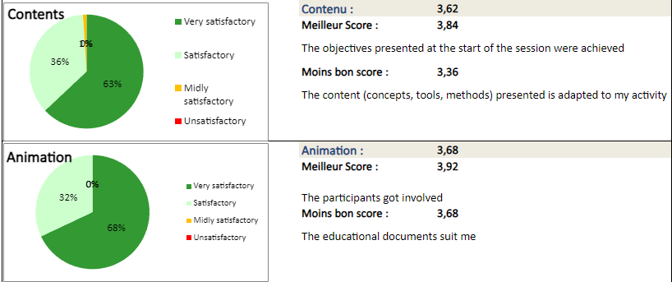
Quantitative evaluation of sessions - Content and animation

Slide 3
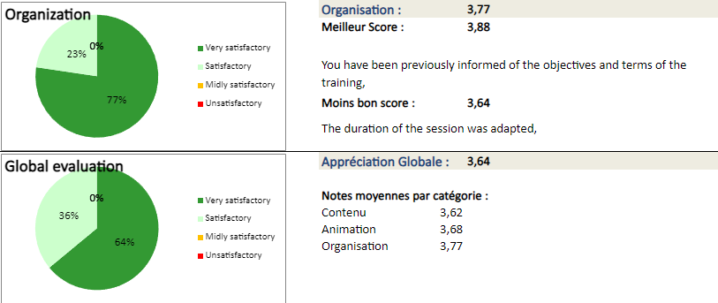
Quantitative evaluation of sessions - Organization et global evaluation

